Slide 1
DATA SCIENCE FOR ECONOMISTS
ECON 220 LAB
Jafet Baca-Obando
Week 5, Normal and Binomial Distributions – 09/26/2025

Slide 2
Outline
Basic data analysis
The normal distribution
The binomial distribution

Slide 3
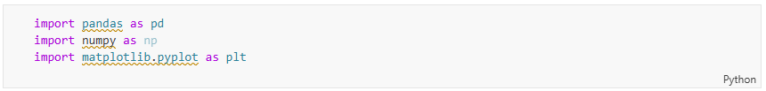
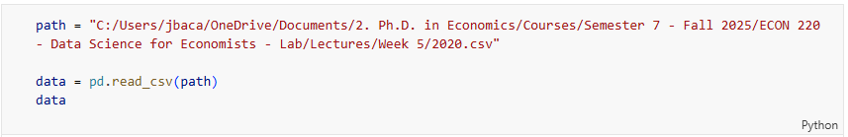
Importing required libraries and dataset

Slide 4
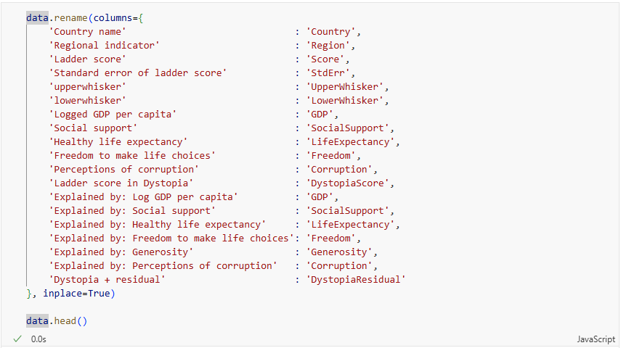
Renaming columns

Slide 5
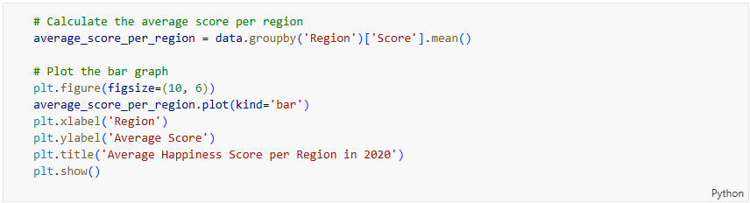
Which region is the happiest, on average?

Slide 6
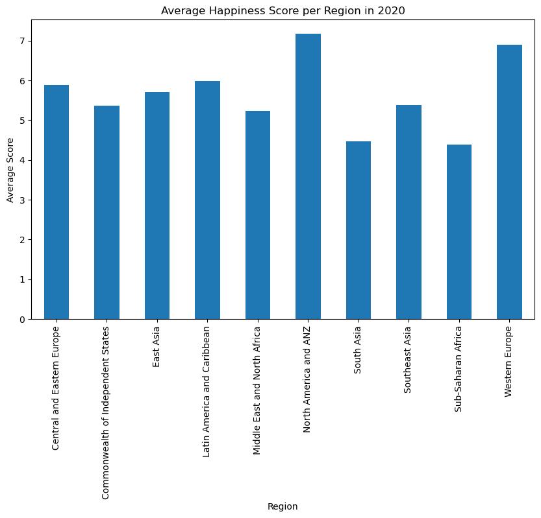
Which region is the happiest, on average?

Slide 7
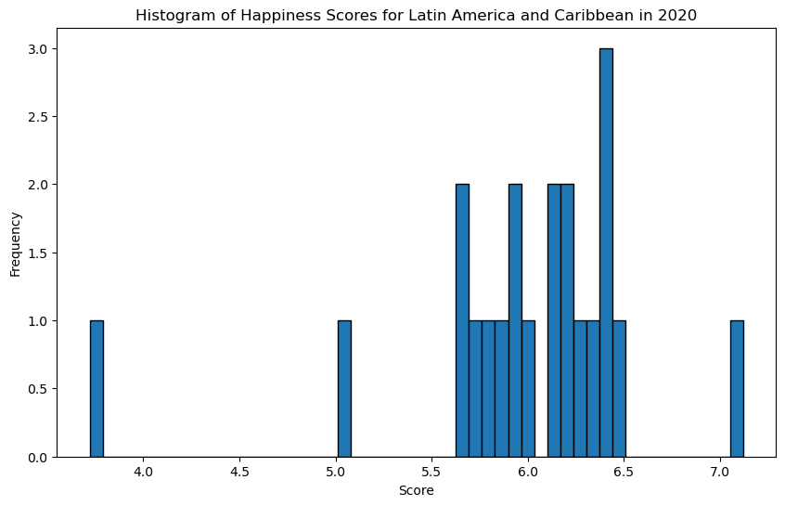
Is the happiness score of LATAM countries normally distributed?

Slide 8
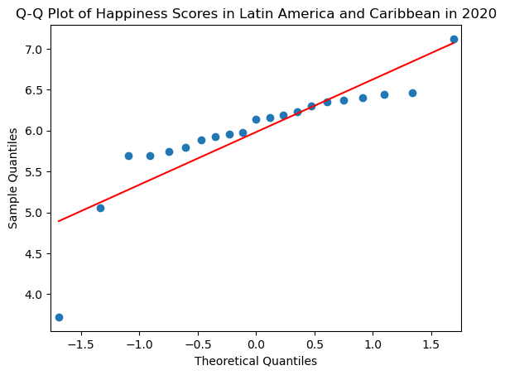
Is the happiness score of LATAM countries normal?

Slide 9
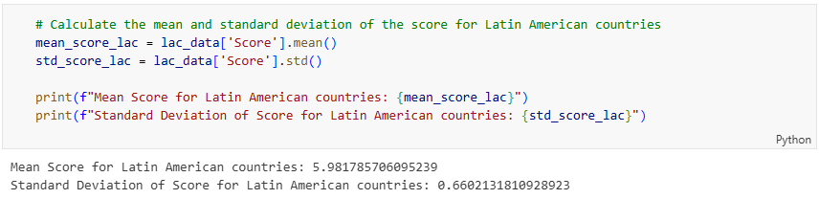
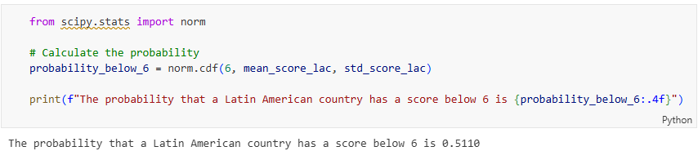
What is the probability that a LATAM country has a score below or equal to 6? Normal distribution

Slide 10
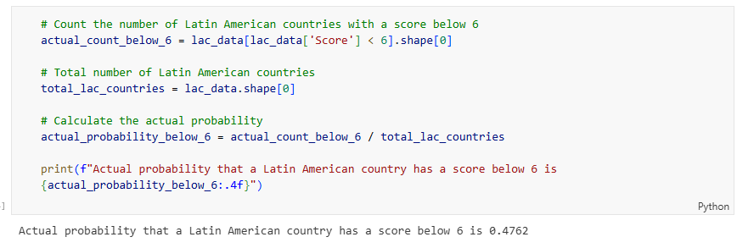
What is the probability that a LATAM country has a score below or equal to 6? Actual data

Slide 11
The binomial distribution
Suppose we want to know the likelihood that a country has a score greater than 6 out of a sample of 6 countries.
We can do this with the binomial distribution
Assumptions
  Countries are assumed to be independent from each other
  There is a fixed number of countries,
  A country can have a score greater than 6 or less than or equal to 6 (i.e.. two possible outcomes)
  Each country is equally likely to be chosen in the sample

Slide 12
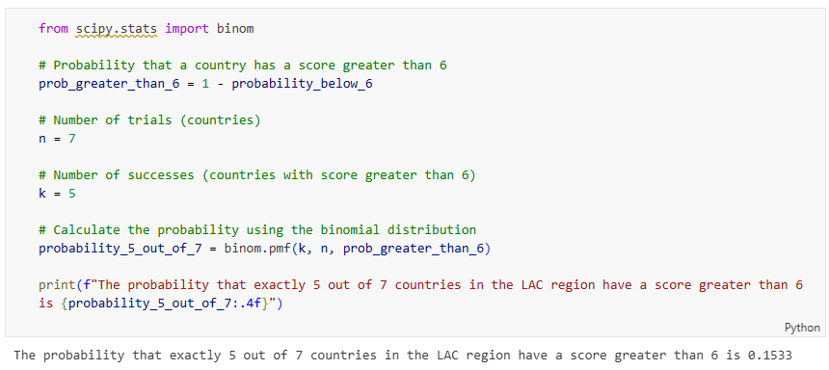
The binomial distribution

Slide 13
Recap
We analyzed the 2020 World Happiness Index data using Python.
We learned how to compute probabilities using the normal distribution.
We learned how to compute probabilities using the binomial distribution.

Slide 14
To-do list
Complete Data Exercise 2
  Upload Jupyter notebook (.ipynb file) and HTML file on September 28.
Complete Data Exercise 3
  Upload Jupyter notebook (.ipynb file) and HTML file on October 5.

